Slide 1
Poplar Elementary School
Distance Learning in the School Setting and
Re-opening Next Steps
2020-2021

Slide 2
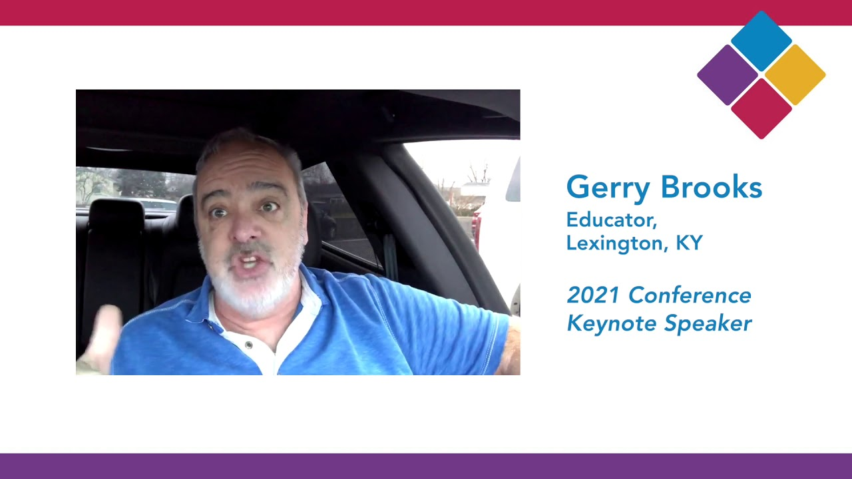
What does Distance Learning Look Like and what’s Next?
https://www.youtube.com/watch?v=T64PREdnfpk
https://www.youtube.com/watch?v=Of6GXZOmkS0

Slide 3
Distance Learning Changes Education
Students working from home with laptops
Students are engaging in the classroom
Students encounter technology issues
Students’ learning is at a slower pace for some
Parents still have to work and come home and support their children
Parents cannot support because of the language barrier
Parents do not have Wi-Fi
Parents are overwhelmed

Slide 4
Schools Provide Support for the Families
Food is given to the families for 7 meals every Wednesday
Materials for students – pencils, papers, whiteboards, hands on materials, textbooks, reading books, are distributed
Kaiser Permanente passes out stress balls and other items to our students
Pumpkins for students and will be packaging Turkey Dinners for pick up on November 24th
Counseling is available to all families and students
Technology support – exchange laptop, hotspots, etc.

Slide 5
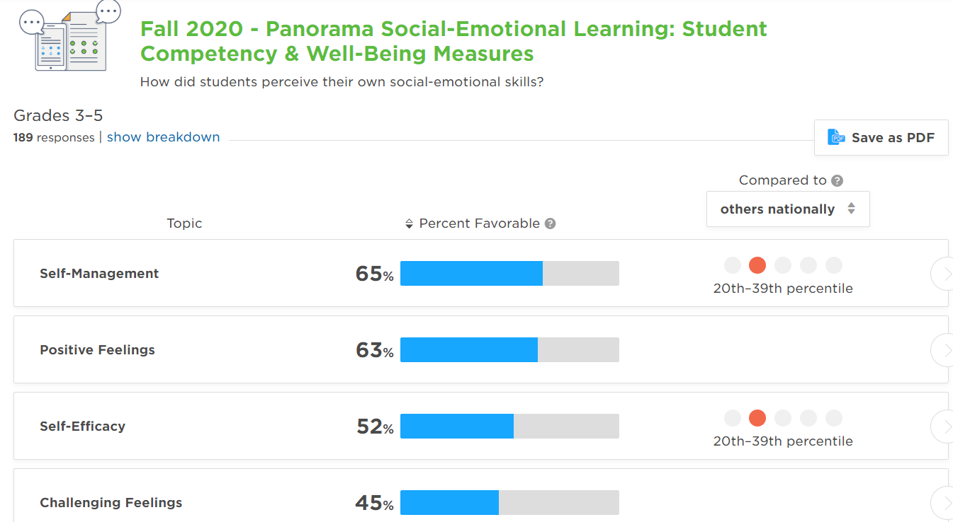
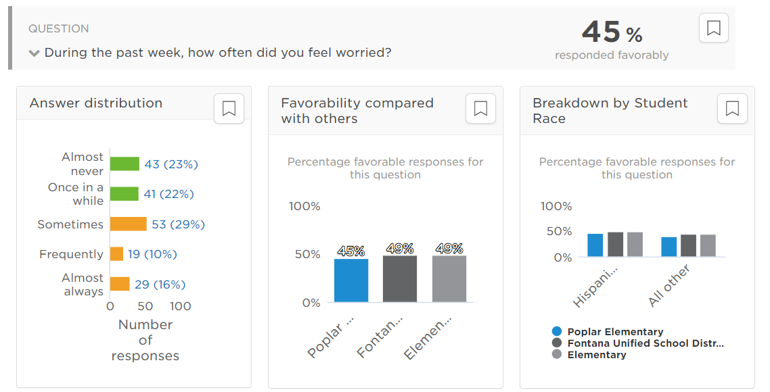
Emotional Well Being of our Students

Slide 6
What safety measures and plans are in place to return to a physical campus?
Follow FUSD Health and Safety Plan 20-21
Weekly Covid- 19 checks with our i- Auditor app.
When the county moves to a new tier the plans will be in place to move forward with our negotiations teams
Thermometers and Thermo scanners are on campus for scanning all students and staff
Signage is posted for Social Distancing and mandatory masks
Footprint stickers are on the ground showing students were to stand (6 feet apart)
Hybrid model differs per district
One- way hallways so students are socially distant
For FUSD Elem. tentative for now- Desks are arranged with A/B Stickers and Cohort A will be Monday- Tuesday and Cohort B will be Thursday- Friday.
If students show symptoms or are identified, we have an isolation room (care room).

Slide 7
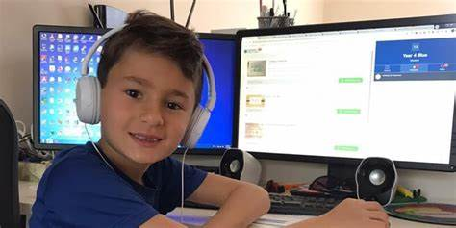
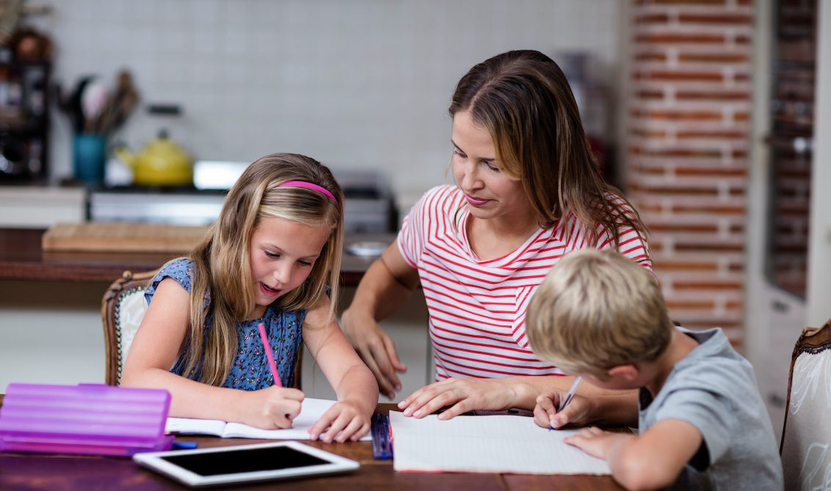
will students be in school in the coming year?

